Slide 1
IBM Data Science – Capstone Project
COVID-19 / Medical Facility Analysis
Alex Newman May 2020

Slide 2
Executive Summary
There is no correlation (0.14) between death rates and the number of medical research labs within a 4km radius of the associated capital city center.
The categorisation of European countries by death rates highlights the perception that countries such as Italy (medium), Spain (medium) & the UK (medium) are the worst affected in Europe is not true. In comparison Belgium (high) and San Marino (very high) have a far higher death rate.
The quality of the data used in this investigation is questionable due to the lack of documentation regarding the categorisation employed by FourSquare and restrictions experienced in obtaining data regarding medical research facilities (licensing limitations). An example of unusual data is the lack of medical research labs in Moscow.

Slide 3
Introduction – Business Problem
After a recent surge in public attacks against medical laboratories due COVID-19, the World Health Organisation (WHO) have engaged the services of a wannabe data scientist.
The WHO require an investigation into the conspiracy theory involving the prevalence of medical laboratories and the death rate of the associated country.
Specifically they require:
European countries to be assigned to a category based on COVID-19 death rate
Establish if there is a correlation between medical laboratories and death rate

Slide 4
Data
The investigation used data from the following three sources:
Wikipedia – Country populations and Covid-19 statistics
FourSquare – Medical Research facility information & geocoding of Capital cities
Nations Online – Country information (Capital City identification)

Slide 5
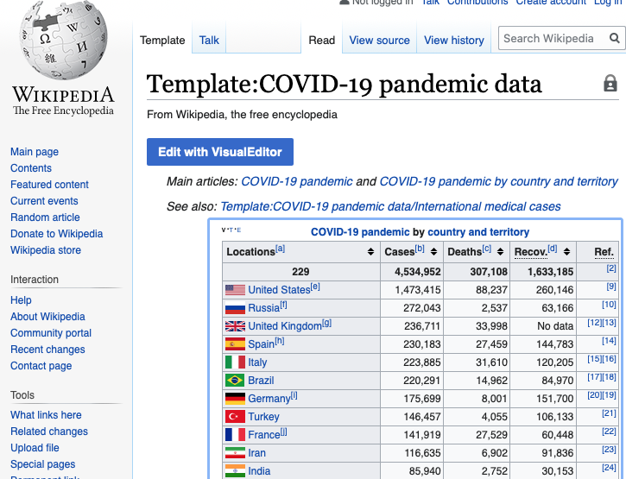
Data Example – Wikipedia Covid-19 statistics

Slide 6
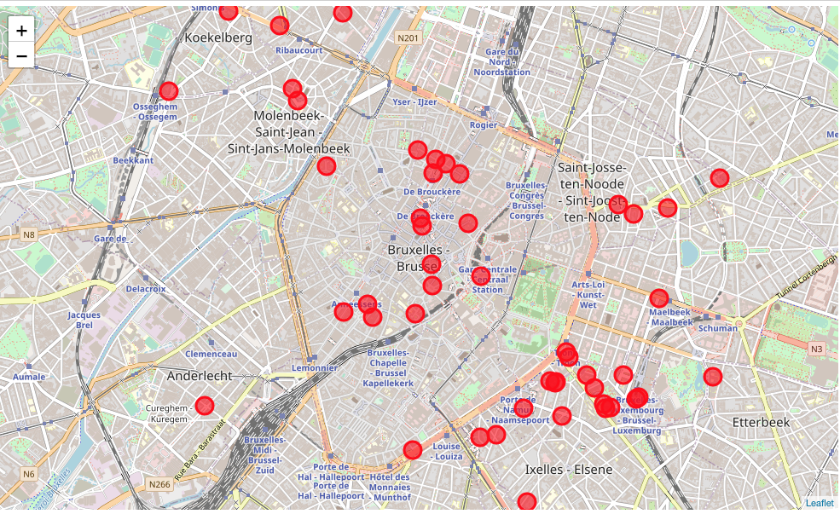
Data Example – FourSquare Medical Research Facility
Brussels – Medical Research Laboratories – 4km radius from city center 50 returned results

Slide 7
Methodology
Pull and Clean datasets
Create COVID-19 Death Category
join covid-19 data with country population data and calculate death rate (deaths / population)
create a three tiered category based on death rate (high medium low)
produce European map of death rate categories
3. 4square 'medical' data
geocode all European capital cities
pull all medical labs for each ~44 European capital cities within a 2km radius
count all medical labs for each ~44 European capital cities within a 2km radius
produce a European map medical lab counts
4. Investigate a correlation between Death rate of country and the number of medical facilities
plot death rate against number of facilities
investigate results

Slide 8
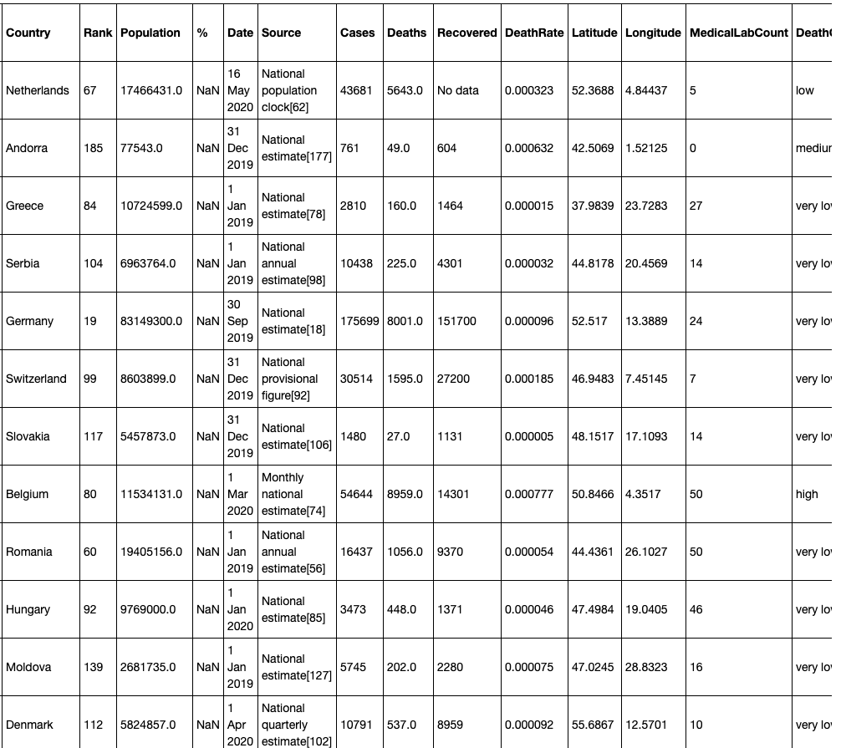
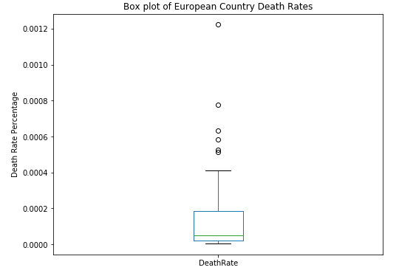
Results - Categories
London – Medical Research Laboratories
40 European Countries were classified based upon the death rate from COVID-19. Death rate was calculated by dividing the number of COVID-19 related deaths by the population per country. 5 categories were created ranging from very high to very low.
A Box Plot was created that clearly identified outliers:
Box Plot - European Country Death Rates

Slide 9
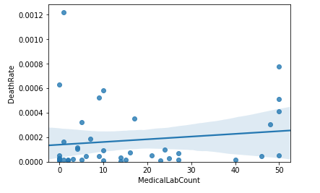

Results - Correlation
There was no correlation between death rate and the number of Research facilities located with in a 4 km radius of the capital city.
Histogram – Death Rate / Medical Research Laboratory
Death Rate / Medical Research Laboratory Correlation

Slide 10
Discussion
Interestingly Italy, Spain and the UK were rated as having medium death rates despite the media attention of these countries due to their perceived high death rates.
The quality of FourSquare data is very variable depending on the country concerned. The query on Moscow medical reasearch facilities netted zero returns. The lack of data out of Russia could have seriously affected the correlation result.

Slide 11
Recommendations
Further research is required to determine the accuracy of the FourSquare data and to investigate if alternative data sources would yield different results.
Increasing the Foursquare search criteria to 100km potentially would yeild significantly different results. This would require a modification to the current license employed by our wannabe data scientist.

Slide 12
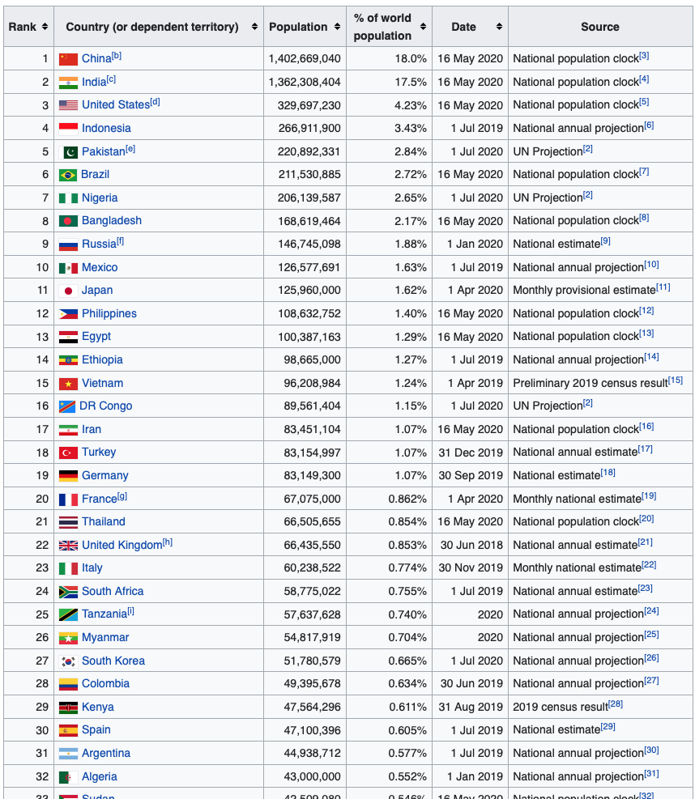
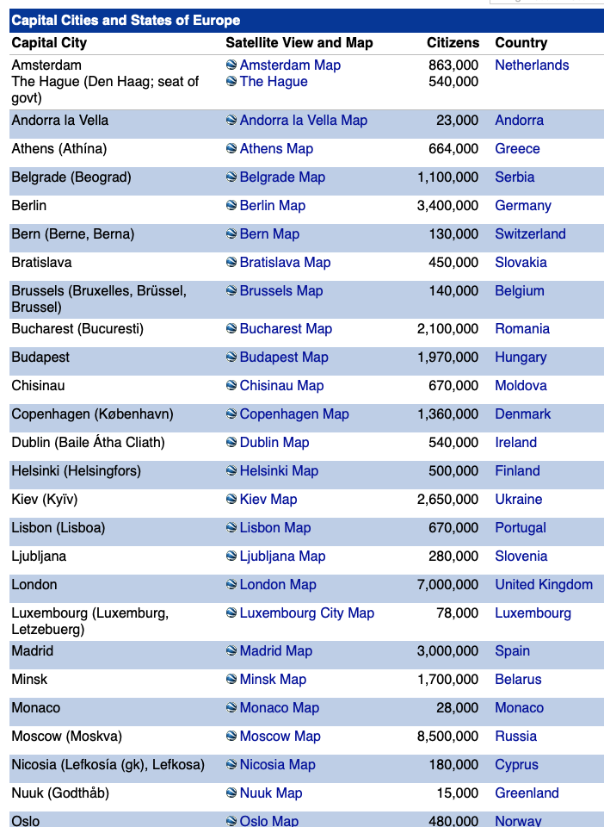
Appendix A – Data Examples

Slide 13
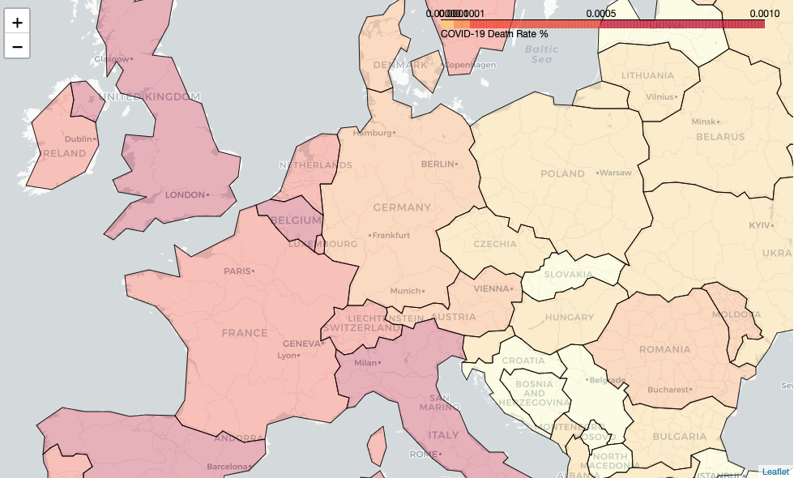
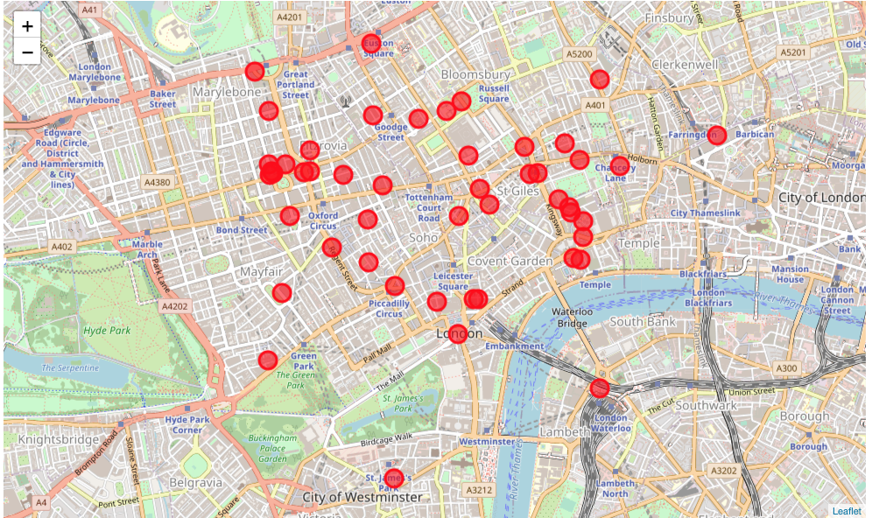
Appendix B – Result (tables, graphs & maps)
Death Rate / Medical Research Laboratory Correlation
London – Medical Research Laboratories
London – Medical Research Laboratories
European – Death Rate Categories
Brussels – Medical Research Laboratories
Histogram – Death Rate / Medical Research Laboratory
Box Plot - European Country Death Rates

